Slide 1
Digital image processing and analysis Introduction
Professor Ela Claridge
School of Computer Science

Slide 2

In this lecture we shall find out about:
FIJI (ImageJ) image processing and analysis software
Essentials
Basic concepts
Overview of functions and tools
Macros and programming

Slide 3
ImageJ is Free Software
ImageJ is public domain open source software. An ImageJ user has the four essential freedoms defined by the Richard Stallman in 1986:
The freedom to run the program, for any purpose.
The freedom to study how the program works, and change it to make it do what you wish.
The freedom to redistribute copies so you can help your neighbor.
The freedom to improve the program, and release your improvements to the public, so that the whole community benefits.

Slide 4
Essentials
FIJI package is available on several computer clusters on the campus
To start-up
Open the package by selecting ImageJ-Fiji from the applications menu. Ignore any warnings / requests for updates etc.

Slide 5
FIJI menu bar
Tool bar
Status bar

Slide 6
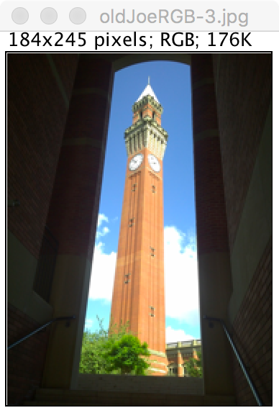
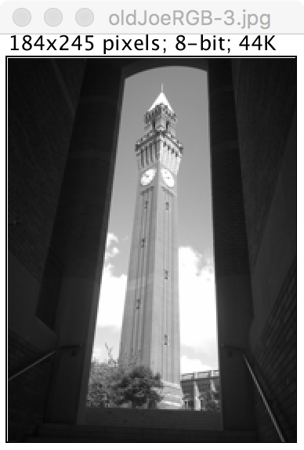
Images
Formats
TIFF, GIF, JPEG, PNG, DICOM, BMP, PGM and FITS
Types
Colour image
Greyscale image
Image stack

Slide 7
Images
Opening image – options
File → New (new blank image canvas)
Open (an existing image from a folder)
Samples (a collection of FIJI sample images)
Recent (previously opened images)
Multiple images
The active window has its title bar highlighted
All operations are performed on the active image

Slide 8
Image duplication, selection and copying
It is often necessary to compare the results of different operations applied to the same image.
Duplicate image (Image → Duplicate)
You can give the image a new name, or leave a default name suggested by the system
To insert a copy of an image to your document (e.g. Word, Powerpoint)
Select an image by clicking on it
Choose Edit → Copy to System then paste into the document

Slide 9
Tools

Slide 10
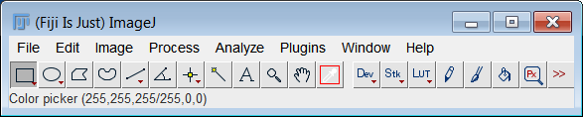
Selections
Selections: user defined areas or lines within an image
Only one selection can be active at a time
Selections can be moved by clicking and dragging
Area selections can be measured, filtered and filled
Line selections can be measured

Slide 11
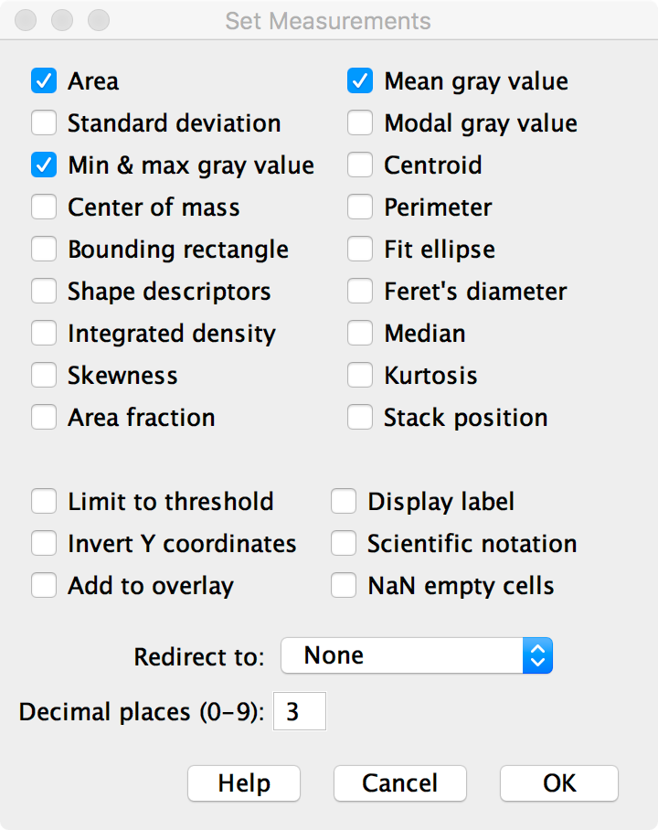
Measurements
Analyze→ Set Measurements lets you select the desired measurements

Slide 12
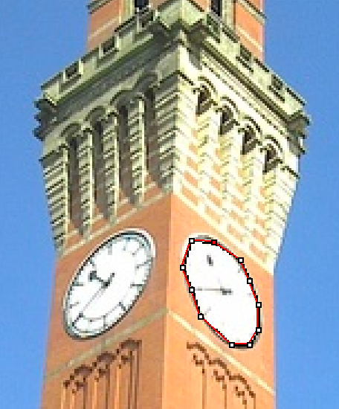
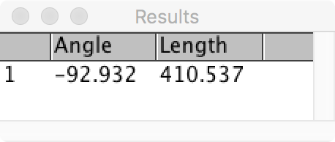
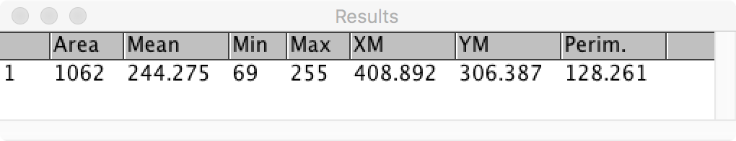
Measurements

Slide 13
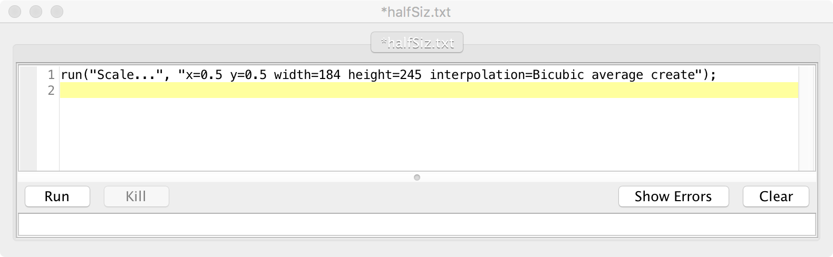
Macros and macro language
A macro is a simple program that automates a series of ImageJ commands
A series of commands can be recorded using the command recorder (Plugins → Macros → Record)
A macro is saved as a text file (Plugins → Macros → Run)
It can be executed by selecting a menu command (Plugins → Macros → Record)
This macro recorded image scaling, to reduce its size by half.

Slide 14
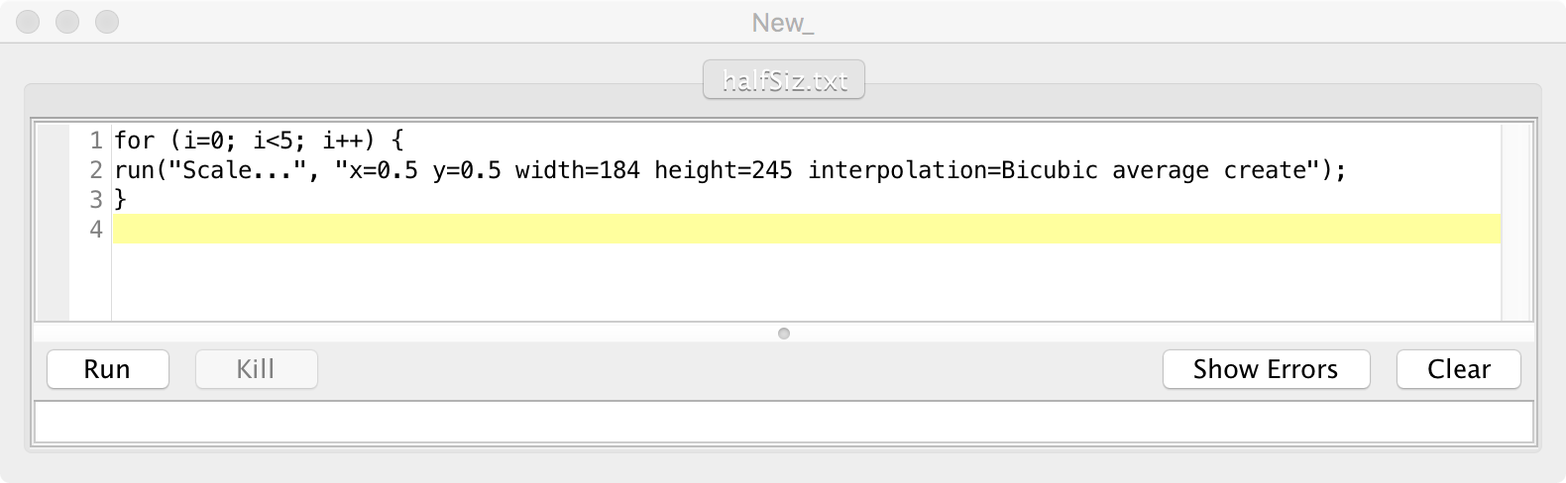
Macros and macro language
Additional commands can be added with a macro editor (Plugins → Macros → Edit)
This example shows how to repeat the image scaling five times by adding the “for loop” around a single command
The result is shown on the next slide

Slide 15
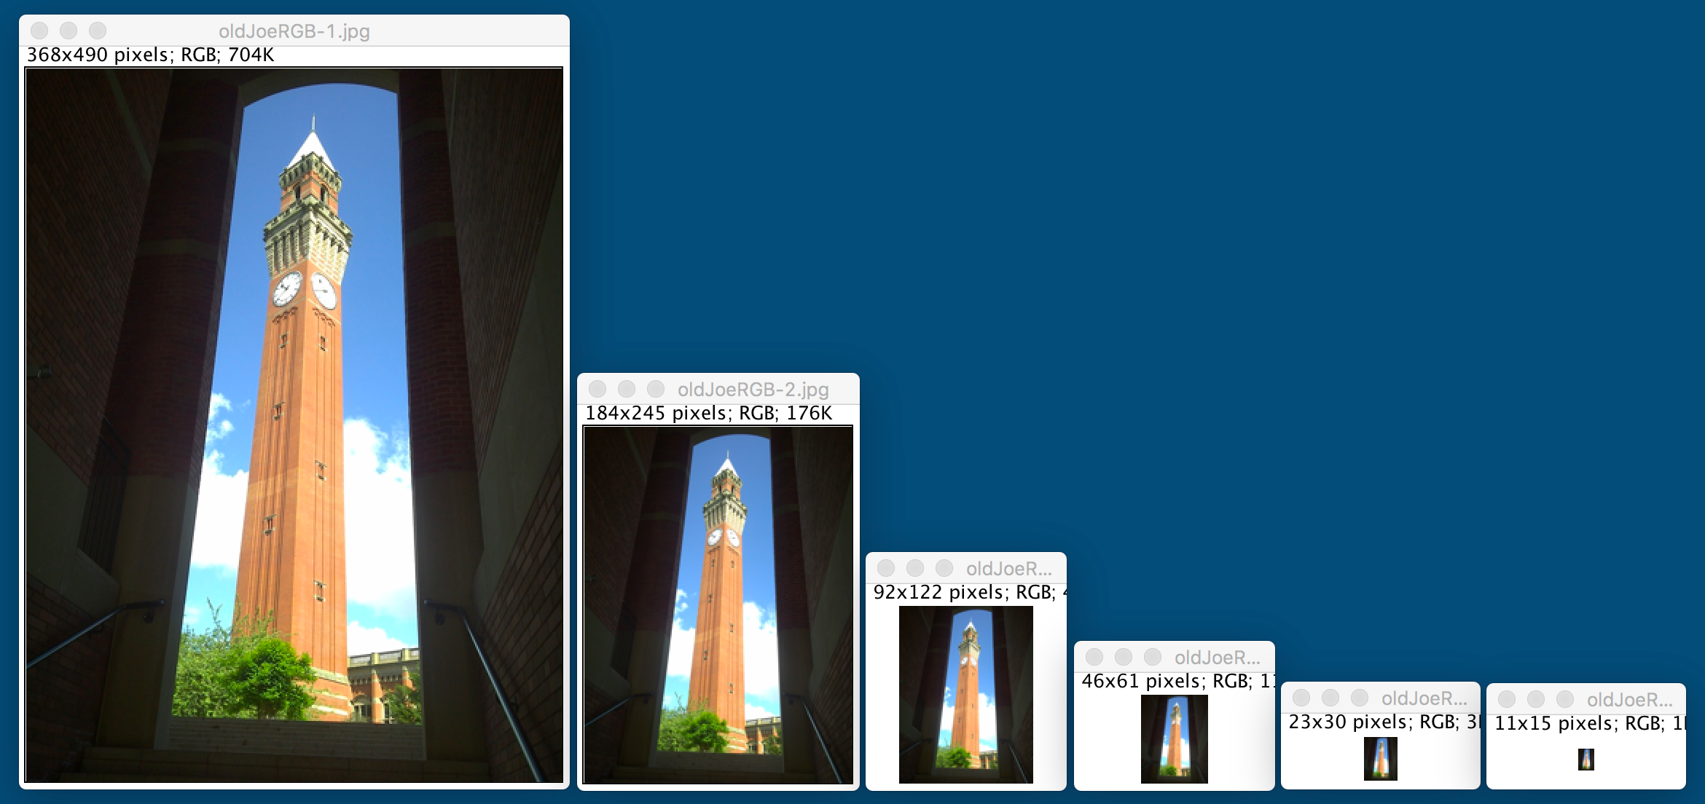
Macros and macro language

Slide 16
Further reading and exploration
FIJI: Introduction and basics https://imagej.nih.gov/ij/docs/intro.html
FIJI: Macros https://imagej.nih.gov/ij/developer/macro/macros.html
FIJI package is available on most computer clusters on the campus. Familiarise yourself with FIJI in your own time before the next lab session

Slide 17
In this lecture we have covered:
Introduction to FIJI (ImageJ)
Essentials
Basic concepts
Overview of functions and tools
Macros and programming

Slide 18
Next lecture
Colour: physical origins, perception and characterisation

Slide 19
Next lecture
Image formation
Digital image acquisition
Visual perception
Cameras and other imaging devices
… and how these two compare

